Slide 1
Medical Decision Making
Paula Parpart
March 13th, 2017

Slide 2

Are there any doctors in the room?
Notes:
Then we can use you as experts for today’s lecture.
Ok then we wont have any experts to test

Slide 3
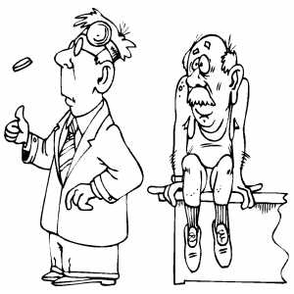
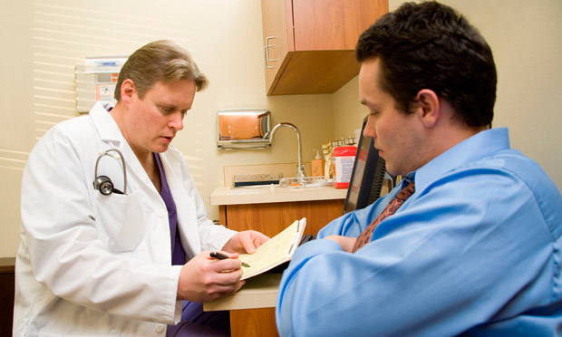
Medical Decision Making
Doctor cannot be certain
Complex decision environment
Time pressure
High cost of being wrong..

Slide 4
Outline
Heuristics in Medicine: Fast-and-Frugal Trees
Different approaches to diagnosing
Use of natural frequency formats
Diagnosis as categorization: Prototypes vs. Exemplar Models
Physicians Representations: Schema and Illness Scripts

Slide 5

Scenario – Michigan ER
Accompanied by his anxious wife, a middle-aged male patient arrives at a rural Michigan hospital. He suffers from serious chest pain. The physician in charge suspects acute ischemic heart disease, but is not entirely sure. Should she assign the patient to a regular nursing bed for monitoring? If it really is acute ischemic heart disease, however, the patient needs to be rushed immediately to the coronary care unit. On the other hand, unwarrantedly sending the patient to the care unit is not only expensive, but can also decrease the quality of care for those patients who need it, while those who do not are exposed to the risk of catching a potentially harmful, hospital-transmitted infection.
How shall she decide?

Slide 6
Scenario
What are possible approaches to solve the emergency room situation?
Let doctors decide.
Solve the problem with a complex algorithm.
Use of heuristics
…

Slide 7
Scenario
Let doctors decide.
In the rural Michigan hospital, doctors sent 90% of patients with severe chest pain to the coronary care unit; as a consequence, it became overcrowded, the quality of care decrease, and costs went up.

Slide 8
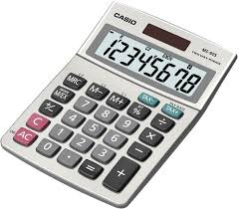
Scenario
Solve the problem with a complex (optimal) algorithm.
Team of medical researchers at University of Michigan developed the Heart Disease Predictive Instrument:
All information on 7 symptoms in a combined and weighted form → a chart with some 50 probabilities
→ Uses linear regression
→ Requires calculator
Notes:
If a doctor wanted to determine a patient’s probability of having acute heart disease based on this chart, she needed to check the presence and absence
of combinations of 7 symptoms and insert the relevant probabilities into a pocket calculator.
many doctors disliked using the HDPI because of its complexity and lack of transparency → calculators were not used once the scientists left

Slide 9
Scenario
3) Use of heuristics.
Heuristics are simple decision strategies that deliberately ignore part of the available information (Marewski & Gigerenzer, 2012).
Fast-and-frugal decision trees for medical treatment allocation (Green & Mehr, 1997; Wegwarth et al., 2009, Marewski & Gigerenzer, 2012)
Ignores all probabilities
Instead asks only Yes/No questions
Artificially binarizes the problem
Choose variables (“nodes”) wisely

Slide 10
Fast-and-Frugal Tree (FFT)
Should the patient be assigned to the coronary care unit or a regular nursing bed?
FFT is a simple heuristic
Sequential steps
Only yes/no questions
ST-segment = anomaly in the electrocardiogram
Notes:
Specifically, if a certain anomaly appears in the patient's electrocardiogram (ie, an ST-segment change), the patient is immediately
sent to the coronary care unit.
No other information is considered.
If there is no anomaly, a second variable is taken into account, namely whether the patient’s primary complaint is chest pain.
If not, the patient is classified as low risk, and assigned to a regular nursing bed. Again, no additional information is considered.
If the answer is yes, a third and final question is asked to classify the patient.

Slide 11
Can following the Fast-and-Frugal Tree enable doctors to make good allocation decisions?

Slide 12
Results in Michigan Hospital
Heuristic resulted in
Larger sensitivity = proportion of patients correctly assigned to c.c.u.
Lower false-positive rate = proportion of patients incorrectly assigned to c.c.u.
Sensitivity
False Positives
Notes:
Note that the Heart Disease Predictive Instrument’s allocation decisions depend on how sensitivity is traded off against the false-positive rate. This is why several
data points are shown for this instrument.

Slide 13
Contrasting different approaches
Optimization:
Optimization models: Bayesian inference, maximization of subj. expected utility → optimal statistical models
When judging whom to treat, optimization models assume that decision maker will collect and use all information, weight each piece of info according to some criterion and combine pieces to maximize chances of attaining their goals
Heart Disease Predictive Instrument uses linear regression model to compute optimal beta weights.
$$Y_{i }= β_{1}∗ST+β_{2}∗Var2+β_{3}∗Var3+β_{4}∗Var5+β_{4}∗Var5+β_{5}∗Var5+β_{6}∗Var6+..$$

Slide 14
Contrasting different approaches
Cognitive Biases Approach:
Heuristics-and-biases framework: Humans commit systematic errors when judging probabilities and making decisions.
→ still makes optimization (maximizing expected utility) as normative yardstick
Sensitivity
False Positives
Notes:
one might argue that the physicians’ large false-positive
rate and below-chance performance in making allocation
decisions (Figure 2) reflect the workings of their
limited cognitive abilities.

Slide 15
Contrasting different approaches
Ecological Rationality:
Bounded rationality (Simon, 1990) assumes that optimization is rarely possible in the real world
→ people use simple heuristics that, seeking solutions that are good enough with respect to goals
Fast-and-Frugal Heuristics are successful due to fit with environment, they are ecologically rational
Sensitivity
False Positives
Notes:
one might argue that the physicians’ large false-positive
rate and below-chance performance in making allocation
decisions (Figure 2) reflect the workings of their
limited cognitive abilities.

Slide 16
Contrasting different approaches
Ecological Rationality:
Physicians “err on the safe side” may in fact be ecological rational.
Court trial: Daniel Merenstein, a family physician in Virginia, was sued because he had informed a patient about pros and cons of prostate-specific antigen (PSA) test, instead of just ordering one. He followed recommendations of leading medical organizations
Patient later developer incurable prostate cancer
Was liable for 1$ million
Sensitivity
False Positives
Notes:
one might argue that the physicians’ large false-positive
rate and below-chance performance in making allocation
decisions (Figure 2) reflect the workings of their
limited cognitive abilities.

Slide 17
Contrasting different approaches
What does this lead to?
Over-diagnosing.
US physicians: 93% of over 800 surgeons, obstetricians and other specialists at high risk of litigation reported recommending a diagnostic test that is not best option for patient, but that protects the physician against the patient. (Studdert et al.,)
Not ecological rational. Environment needs changing.
Sensitivity
False Positives
Notes:
unnecessary CT scans,
biopsies, and MRIs, and more antibiotics than medically
indicated.

Slide 18
Heuristics in Medicine
Goal should be to formalize and understand heuristics so that their use can be effectively taught to doctors
Challenge is to find under what circumstances a heuristic performs well– match between strategy and environment
e,g., Fast-and-Frugal trees are routinely used in HIV testing and cancer screening, Backlund et al (2008) for diagnosing heart failure, Dhami & Harries (2007) - FFT as good as regression model in practitioners decisions to prescribe lipid-lowering drugs for hypothetical patients
Notes:
Note that the Heart Disease Predictive Instrument’s allocation decisions depend on how sensitivity is traded off against the false-positive rate. This is why several
data points are shown for this instrument.

Slide 19
Heuristics in Medicine
Teaching doctors heuristics to deal with complex information
Evidence suggests that doctors often struggle with statistics, the info on which medical diagnosis should be based.
Transparency is needed to better understand health statistics.
Notes:
Note that the Heart Disease Predictive Instrument’s allocation decisions depend on how sensitivity is traded off against the false-positive rate. This is why several
data points are shown for this instrument.

Slide 20
Heuristics: Mammography Screening
Gigerenzer et al (2007) gave 160 gynaecologists the statistics needed for calculating that a woman with a positive breast cancer screening mammogram actually has cancer.
Sensitivity of 90%
False-positive rate of 9%
Prevalence of 1%
Question: What would you tell a woman who tested positive about her chances of having breast cancer?
Shocking results:
60% of gyncologists believed that 8 o 9 out of 10 women who tested positive would have cancer
18% thought that chances were 1 in 100
Notes:
Note that the Heart Disease Predictive Instrument’s allocation decisions depend on how sensitivity is traded off against the false-positive rate. This is why several
data points are shown for this instrument.

Slide 21
Heuristics: Mammography Screening
Gigerenzer et al (2007) gave 160 gynaecologists the statistics needed for calculating that a woman with a positive breast cancer screening mammogram actually has cancer.
Sensitivity of 90%
False-positive rate of 9%
Prevalence of 1%
Question: What would you tell a woman who tested positive about her chances of having breast cancer?
Change mathematical format to natural frequencies:
When format was changed, 87% of gynaecologists understood that 9+89=98 will test positive.
Notes:
Note that the Heart Disease Predictive Instrument’s allocation decisions depend on how sensitivity is traded off against the false-positive rate. This is why several
data points are shown for this instrument.

Slide 22
Heuristics: Mammography Screening
Gigerenzer et al (2007) gave 160 gynaecologists the statistics needed for calculating that a woman with a positive breast cancer screening mammogram actually has cancer.
Sensitivity of 90%
False-positive rate of 9%
Prevalence of 1%
Question: What would you tell a woman who tested positive about her chances of having breast cancer?
Change mathematical format to natural frequencies:
Of these 98, only 9 will actually have breast cancer, equalling roughly 1 out of 10 (10%). The remaining 9 out of 10 are false alarms.
Notes:
Note that the Heart Disease Predictive Instrument’s allocation decisions depend on how sensitivity is traded off against the false-positive rate. This is why several
data points are shown for this instrument.

Slide 23
Challenging FFT – What critiques do you have?
It doesn’t always work out like in this scenario. Sometimes the outcome may be more like this:
Let doctors decide.
Solve the problem with a complex algorithm.
Use of heuristics
FFTs will not always be applicable. It depends on the structure of the data. They are optimized for a particular situation.
Finding good decision nodes is hard. Finding a good amount of parameters is the challenge. (fit & generalizability)
The questions need to be validated with experts and tested extensively
→ They hide a lot of the complexity and ‘expertise’

Slide 24
Outline
Heuristics in Medicine: Fast-and-Frugal Trees
Different approaches to diagnosing
Use of natural frequency formats
Diagnosis as categorization: Prototypes vs. Exemplar Models
Physicians Representations: Schema and Illness Scripts

Slide 25
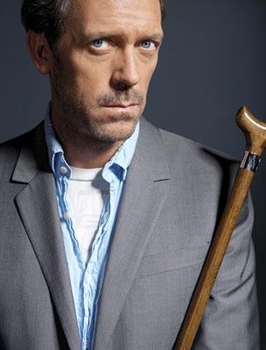
Diagnosis as categorization
Prototypes
Exemplars
Notes:
Custers s

Slide 26
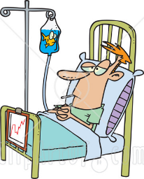

Prototype theories
Diseases represented as prototypes or via prototypical patients
Abstract representation of previously encountered patients
Eg Set of weighted features
Summary descriptions
Ideal exemplar
symptom1
w1
w2
symptom2
disease
w3
symptom3
w4
symptom4

Slide 27
Prototype theories: Pros
Explains rapid diagnosis of typical patients
Mention of features in specific order -> from most to least typical
Prototype theories: Cons
Features treated independently, so ignores possible interactions between features
Ignores time component: disease – symptom time course

Slide 28
Instance-based (Exemplar) theories
Categories represented by individual instances
Memories of previously encountered patients are stored and used to diagnose new cases
Diagnosis based on overall similarity between new case and previous items
Context can also be stored with the individual instances

Slide 29
Exemplar-based theories: Pros
Explains why people often rely on previous instances even when other rules available
Use of similarity between current case and previous case
Explains influence of context specificity
Inclusion of patient context factors can facilitate diagnosing of new cases (Hobus et al., 1987)
Exemplar theories: Cons
Hard to test in real-world medical diagnosis
Unlikely that doctors recall all instances
Activation of instances does not entail that they are used in diagnosis…

Slide 30
Common problem
How do instance-based or prototype theories decide which features or similarities to use for categorization?
Suppose all patients with disease X seen by doctor have brown hair
Should brown hair be included in prototype? Should new instances with brown hair be judged relevantly similar?
‘ultimately, it is the ability to explain why features co-occur, or why instances resemble each other, that determines whether it makes sense to include them in the disease’ (Custers et al., 1996)
→ Use of theory/causal knowledge
Notes:
3rd bullet: But this is not in the prototype or instance-based theories

Slide 31
Doctor’s Representations in Medical Decision Making

Slide 32
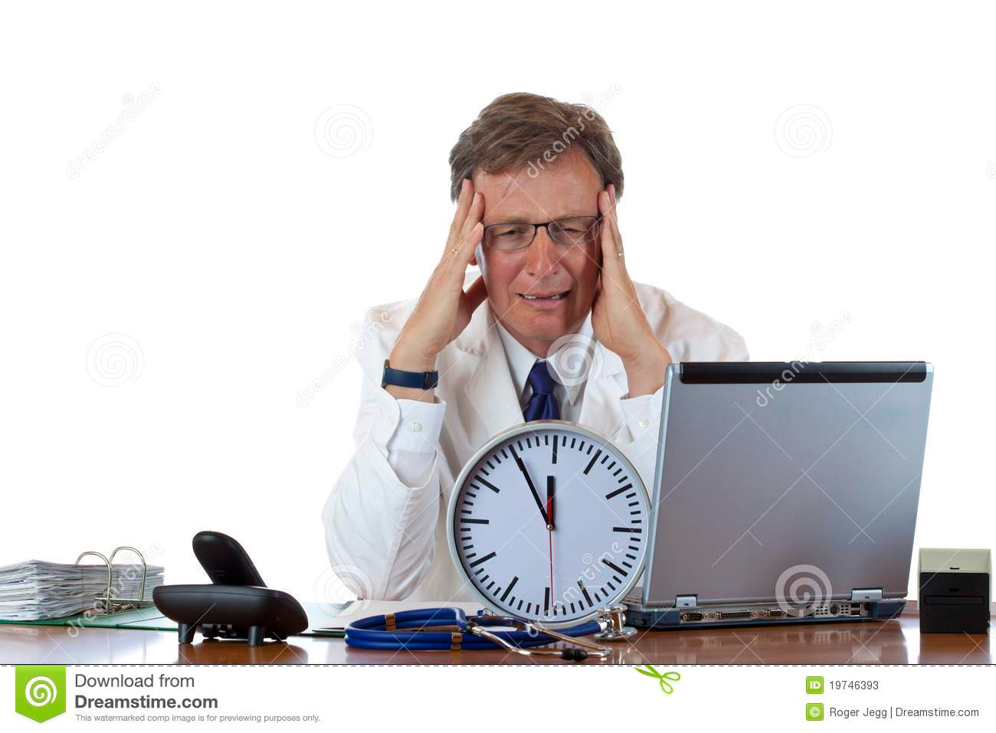
Illness Scripts
In clinical contexts, physicians often have to reason under time pressure
No time for long deliberations based on “first principles” of biomedical knowledge
“scripts” provide an efficient representation for storing and using medical knowledge
Notes:
Frequently co-occurring signals will be chunked together to form schemas or scripts for a particular illness

Slide 33
Illness Scripts
Charlin et al., 2000: Illness scripts are narrative structures with three main components
Medical and non-medical contextual patient-related factors that influence the probability of disease
The major real malfunctions typical of an illness – described in biomedical terms
Enabling conditions
(gender, age, smoking, travel, family history...)
Fault
(e.g., invasion of tissue by pathogenic organisms...)
Complaints, signs, symptoms that result from specific fault.
Consequences
(Symptoms: Fever, pain...)
From van Schaik et al. (2005)
Notes:
Some authors see scripts as causal (Feltovich & Barrows), whilst others see them as more associative (Charlin et al.)

Slide 34
Illness Scripts
When does this information become available to the physician?
1.Early in the consultation.
Enabling conditions
(gender, age, smoking, travel, family history...)
Probabilistically related (not deterministic)
Fault
(e.g., invasion of tissue by pathogenic organisms...)
2. Early in consultation (complaints) & learn about consequences as a result of investigation
Consequences
(Symptoms: Fever, pain...)
From van Schaik et al. (2005)

Slide 35

Illness Scripts – How do they work?
Prior knowledge and experience organized in terms of networks of connected concepts → stored in long-term memory (LTM)
Physician activates illness scripts as integrated units, instantiated by the data available on a specific patient.
Search for an appropriate script wen diagnosing a new case
Match the script elements to the patient information → Scripts contain actual features and values of patient (or use of default values)
If the activated script does not fit with actual values, then rejected
Activated scripts will suggest tests and examinations → These in turn provide actual values – iterative process to refine and narrow possible scripts
Active hypothesis testing
Notes:
doctors sometimes actually use memories of previous patients when diagnosing a new case.
Thus, while solving a problem, a doctor searches for an appropriate script and when he has selected 1 (or a few), he will tend to match its
elements to the information provided by the patient.
In the course of this script verification process, the script becomes instantiated.

Slide 36
Illness Scripts
Less experienced physicians are expected to be mainly guided by consequences
Experienced physicians have developed richer illness scripts and use both enabling conditions and consequences in diagnosis (Custers et al., 1996; 1998)
E.g., experts report more enabling conditions & less biomedical factors than novices
Enabling conditions
(gender, age, smoking, travel, family history...)
Fault
(e.g., invasion of tissue by pathogenic organisms...)
Consequences
(Symptoms: Fever, pain...)

Slide 37
Illness Scripts
Given that illness scripts are recalled from long-term memory, they are susceptible to biases and confounding
For example, reported enabling conditions for particular disease was positively related to number of patients seen with that disease
Are doctors immune to cognitive biases?
Representativeness heuristic → base rate neglect? (K & T, 1973)
Availability heuristic → salience bias? → inaccurate prevalence estimates
Influenced by characteristics and outcomes of patients from recent consultations (Wilkins, 1992)

Slide 38

How does expertise develop in medicine?
(review by Schmidt & Rikers, 2007)
The knowledge encapsulation hypothesis
During early medical training, students rapidly develop mental structures that can be described as rich, elaborate causal networks.
Causal networks explain the causes and consequences of disease in terms of underlying biological and pathophysiological processes
When confronted with a clinical case at this stage, students focus on isolated signs and symptoms and attempt to relate them to faults. → effortful and error prone
They do not yet recognize patterns of symptoms.

Slide 39

This can explain the intermediate effect (*Expertise lecture)
Novice | Lay knowledge and basic biology | Effortful & error prone reasoning
Intermediate | Extensive ‘book-learning’ of pathophysiology Eg causal links between diseases and symptoms | Elaborate and effortful reasoning | Better recall of details (with enough time)
Expert | Encapsulation of knowledge through experience with actual cases Develop ‘illness scripts’ | Faster reasoning & less reference to explicit info | Recall of details poorer.
Notes:
It seems obvious now, but before this discovery, expectation was that experts would recall more information than novices and intermediaries
Because they have more knowledge to use fro interpretation etc.

Slide 40
This can explain the intermediate effect (*Expertise lecture)
Novice | Lay knowledge and basic biology | Effortful & error prone reasoning
Intermediate | When thinking aloud while solving clinical cases, lots of references to basic sciences (physiology, biochemistry) for building causal explanation networks. | Use of basic sciences for explanation. | Better recall of details (with enough time)
Expert | References to basic sciences virtually absent in think-aloud protocols of expert doctors. | Less reference to explicit info. | Recall of details poorer.
Notes:
It seems obvious now, but before this discovery, expectation was that experts would recall more information than novices and intermediaries
Because they have more knowledge to use fro interpretation etc.

Slide 41

From Medical Student to Expert
Through extensive use of acquired knowledge & exposure to patient problems, a change in knowledge structure occurs for students.
Their detailed, causal networks become encapsulated into diagnostic labels and higher-level causal models that explain symptoms

Slide 42
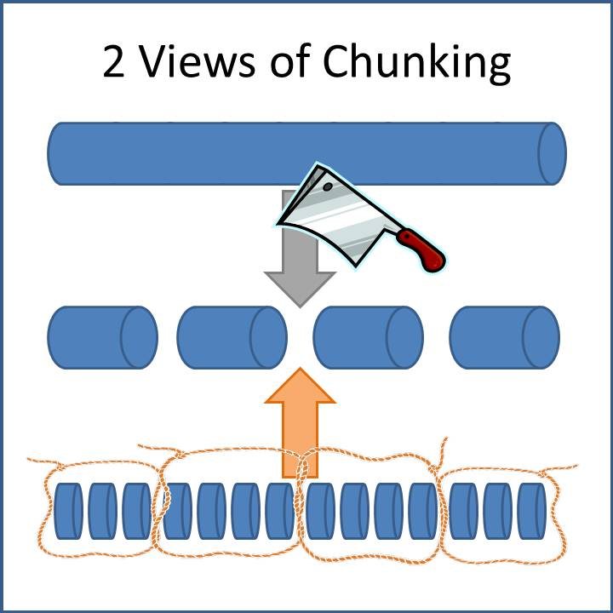
Knowledge Encapsulation is a learning mechanism
‘Packaging’ of lower-level, detailed concepts and their interrelations into a smaller number of higher-level concepts with same explanatory power.

Slide 43
Knowledge Encapsulation: example
Assume that a young man who is suspected to be an intravenous drug addict enters the emergency room. He complains of shaking chills and fever. The fever and chills are accompanied by sweating, and a feeling of prostration. He also complains of some shortness of breath when he tries to climb the 2 flights of stairs to his apartment. Physical examination reveals a toxic looking young man who is having a rigor. His temperature is 41"C. His pulse is 124 ⁄ minute. His blood pressure is 110 ⁄ 40. Mucous membranes are clear. Examination of his limbs shows puncture wounds in his left antecubital fossa.
Year 6 Medical Student would say | Internist would say
“..This man must have been using contaminated needles, which led to an infection with gramnegative bacteria. These bacteria in the bloodstream lead to the activation of antibodies, which explains the fever reaction: the high temperature, the shaking chills, the sweating, the feeling of prostration, and the shortness of breath. The bacteria also release endotoxins, leading to vasodilatation of the arteries. Vasodilatation in turn leads to the observed drop in blood pressure and possibly shock. Decreased resistance may be a reason why the immune response fails… | “This drugs user has developed a sepsis as a result of using contaminated needles.”

Slide 44
Transitory stages in expertise development
(Schmidt & Rikers, 2007)
Development of elaborate declarative networks explaining the causes and consequences of disease in terms of general underlying pathophysiological processes
‘Encapsulation’ of these declarative networks into a limited number of diagnostic labels, syndromes or high-level, simplified causal models, explaining signs and symptoms
Transition into illness scripts through the acquisition of experience-based, contextual or ‘enabling conditions’ knowledge (level of generality: representation of disease categories, prototypes, to individual patients)
Storage of interpreted instances of these scripts as exemplars of the particular illness
Notes:
Possessing knowledge about enabling conditions is supposed to characterise advanced levels of expertise because it enables the doctor to rule out whole categories of disease and to focus immediately on those that are most likely.

Slide 45
Difference in use of Illness Scripts: Experience matters
Studies have shown that the number of enabling conditions associated with particular diseases increases with experience.
Enabling conditions
(“I just returned from Africa”, Influenza outbreak in the UK...)
Fault
(e.g., Influenza, …, Malaria)
Consequences
(Symptoms: Fever, pain...)

Slide 46
Difference in use of Illness Scripts: Experience matters
Study by Hobos et al. (1994): presented 16 short cases consisting only of several enabling conditions and a single complaint → Experts twice as good.
When cases are presented without enabling conditions and only complaint, experts are not any better.
Fault
(e.g., Influenza, …, Malaria)

Slide 47
DYSPHAGIA
= ‘Difficulty swallowing’
Difficulty initiating swallows
Food stops or sticks after swallowing
Scheme – Coderre et al., 2003
Oropharyngeal Dysphagia
Esophageal Dysphagia
Solid food only
Solid or liquid food
Mechanical obstruction
Neuromuscular disorder
Intermittent
Progressive
Intermittent
Progressive
Bread/steak
Chronic heartburn
No weight loss
Chest pain
Chronic heartburn
Age > 50
Weight loss
Bland regurgitation
Weight loss
Lower esophageal ring
Diffuse esophageal spasm
Peptic stricture
Carcinoma
Scleroderma
Achalasia
Notes:
Think-aloud protocols were collected to determine the diagnostic reasoning used by experts and non-experts when diagnosing clinical cases in gastroenterology (disorders of stomach and intestines).
physician seeks specific information from the patient (symptoms, signs, laboratory data) that will distinguish between the categories of conditions at the branching points of the scheme.
The specific information obtained from the patient is related to the general categories of conditions at the branch points of the scheme, and the presence or absence of these clinical findings leads to the adoption of one category
Find a path from signs, symptoms, complaints, to the node representing the diagnosis

Slide 48
Schemas and Scripts
Difference between schema and scripts very poorly specified and dependent on authors. (Charlin et al: scripts have more background/enabling conditions)
When comparing to usual inductive process (reasoning from the clinical data to a diagnosis), the odds of diagnostic success were significantly greater when subjects used pattern recognition and scheme-inductive reasoning as diagnostic strategies (Coderre et al., 2003)
Notes:
Difference between schema and scripts very poorly specified and dependent on authors. For example, Charlin et al. suggest that they are pretty much the same thing, but that scripts are more specific and include more information about time-course and order of events, especially spatio-temporal sequence of events in illness development. General sense is that scripts put more focus on background & enabling conditions.
Some authors see scripts as causal (Feltovich & Barrows), whilst others see them as more associative (Charlin et al.)

Slide 49
Illness scripts: Pros & Cons ???
Rich representations that have potential to cover all aspects of medical diagnosis and treatment
Numerous studies suggest use of scripts by physicians (Charlin et al., 2000; Custers et al., 1996; Van Schaik et al., 2005)
Too powerful? Can explain variety of effects. How can they be refuted?
Some authors see scripts as causal (Feltovich & Barrows), whilst others see them as more associative (Charlin et al.)
Not well formalized; unclear exactly how scripts are generated and evaluated
Has been emphasised that they can be assembled on the fly!
Notes:
3rd pt: Can get a lot of different effects depending on the concepts & structural aspects included…

Slide 50
Pluralism
Different models of knowledge representation suitable for different tasks, domains or stages (Custers et al., 1996)
Instance-based in domains like dermatology and radiology where holistic processing of visual stimuli dominates
Schema in endocrinology¹ and nephrology² where complex causal relations are key
Illness scripts in cases where patient background is important
Prototypes for typical, low variance, high frequency diseases
1 = study of hormones; 2 = study of kidneys

Slide 51
Pluralism
Different representations at different stages of expertise (Schmidt & Boshuizen, 1992)
Less-experienced physicians have to reason through a case using causal networks
Experts have immediate access to relevant scripts
Notes:
Regehr et al. orthogonally manipulated typicality and smimilarity & found that both made independent contributions to diagnosis accuracy in dermatology, concluding that both prototype and instance-based models involved.

Slide 52
Thank you!
Notes:
Regehr et al. orthogonally manipulated typicality and smimilarity & found that both made independent contributions to diagnosis accuracy in dermatology, concluding that both prototype and instance-based models involved.

Slide 53
References
Wegwarth, O., Gaissmaier, W., & Gigerenzer, G. (2009). Smart strategies for doctors and doctors‐in‐training: heuristics in medicine. Medical education, 43(8), 721-728.
Marewski, J. N., & Gigerenzer, G. (2012). Heuristic decision making in medicine. Dialogues in clinical neuroscience, 14(1), 77-89.
Gigerenzer, G., Gaissmaier, W., Kurz-Milcke, E., Schwartz, L. M., & Woloshin, S. (2007). Helping doctors and patients make sense of health statistics. Psychological science in the public interest, 8(2), 53-96.
Chapman (2004). The psychology of medical decision making. In Koehler & Harvey (Eds.), Blackwell Handbook of Judgment and Decision Making.
Charlin, Tardif & Boshuizen (2000). Scripts and medical diagnostic knowledge: Theory and applications for clinical reasoning instruction and research. Academic Medicine, 75, 182-190.
Coderre et al. (2003). Diagnostic reasoning strategies and diagnostic success. Medical Education, 37, 695-703.
Custers, Regehr, & Norman (1996). Mental representations of medical diagnostic knowledge: A review. Academic Medicine, 71, S55-S61.
Elstein & Schwarz (2002). Clinical problem solving and diagnostic decision making: Selective review of the cognitive literature. British Medical Journal, 324, 729-732.
Kushniruk, Patel & Marley (1998). Small worlds and medical expertise: Implications for medical cognition and knowledge engineering. International Journal of Medical Informatics, 49, 255-271.
van Schaik et al. (2005). Influence of illness script components and medical practice on medical decision making. JEP: Applied, 11, 187-199.

